Slide 1
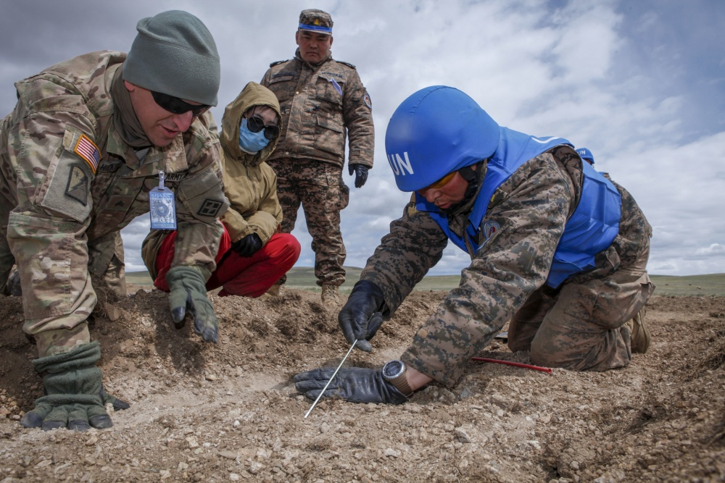
Ethics
Sorting out ethics can feel like a bit of a minefield
"The appearance of U.S. Department of Defense (DoD) visual information does not imply or constitute DoD endorsement."

Slide 2
What are research ethics?
Research ethics are a set of principles addressing how researchers and research organisations should conduct themselves when dealing with research participants, their data or tissue, other researchers and colleagues, the users of their research and society in general. The principles apply whether at every stage throughout the career of a researcher from undergraduate student onward.
The process of ethical review is not intended to impede research activity, but to support the researcher in considering the ethical issues and how to manage them, the process also addresses any potential risks to both the researcher and any participants.

Slide 3
Why are research ethics important?
How many can we get?
Post-it exercise

Slide 4
Ethics is an essential element of good research governance
It helps to support detailed research design and project planning – leading to better experiments and questionnaires
It is not restricted to medical trials - all types of research must consider ethical issues
It is vital to consider the ethical consequences of research to avoid bad practice, harm or stress, loss of data, etc.
Some research may require high level approval in order to be covered by MMU’s insurance: Human tissue, Human embryos, Genetically modified organisms, Animal experimentation, Research Council applications, participants under the age of 16 or pregnant women
Failure to gain the appropriate approval could be viewed as research misconduct and may have serious repercussions.

Slide 5
Some projects have more complex ethics than others
Ethical review may be a legal requirement, if your project involves any of the following you should refer to the legislation section below
Adults lacking the capacity to provide consent
NHS patients (or their close relatives), staff, facilities, premises, data or tissue
Medical devices (this includes creams/ointments, bandages and prosthetics etc.)
Genetically modified materials
Drugs or medicines (licensed or unlicensed)

Slide 6
Outcome
When ethics are considered, this should ensure that the work is acceptable to the research community and other users of the research results.
Permission to do it / co-operate with others

Slide 7
Responsibility
The researcher
This means YOU
How to do it?
Ethos

Slide 8
https://www2.mmu.ac.uk/research/staff/ethics-and-governance/ethics/
EthOS, Forms and Guidance
How to Apply
‌‌Ethical applications at Manchester Met are submitted and processed via EthOS. Use your standard university credentials to log in and select the application route most appropriate for you. If you are unsure of the application route you should use, please contact your faculty research officer (details can be found below).
Click on Access Ethos Link

Slide 9
Supporting materials
Frameworks & Guidance‌
Ethical Framework (Word file)‌
Consent Form Template
The Prevent Duty in Research
Participant Information Sheet
MMU Insurance Checklist document
Health & Safety Risk Assessment Form
Policy for Unit Applications for Ethical Approval
PIA Impact Assessment questionnaire
PIA Impact Assessment form
Information Security Project Template
Information Security Policies and Procedures

Slide 10
Read this document first
Ethical Framework (Word file)‌
THE UNIVERSITY’S ACADEMIC ETHICAL FRAMEWORK
1. Introduction
1.1 This document sets out a framework through which staff and students of the University give consideration to the ethical implications associated with any academic activities with which they engage. The framework and its application will be kept under review by the Academic Board’s Ethics Committee and, where considered necessary, further Guidance Notes consistent with the principles and requirements of the framework will be produced so as to inform and disseminate good practice.

Slide 11
Discuss with your supervisor
If you have been allocated a project set by a superviser, your supervisor will have an idea of the ethics requirements
If you have specified a project which has no connection with your supervisor’s research, do not expect as much support

